Slide 1
MERGE SORT
ANALYSIS

Slide 2
Divide and Conquer
  It is often easier to solve several small instances of a problem than one large one.
    divide the problem into smaller instances of the same problem
    solve (conquer) the smaller instances recursively
    combine the solutions to obtain the solution for original input
Solve(I)
  n = size(I)
  if (n <= smallsize)
    solution = directlySolve(I);
  else
    divide I into I1, …, Ik.
    for each i in {1, …, k}
      Si = solve(Ii);
    solution = combine(S1, …, Sk);
  return solution;

Slide 3
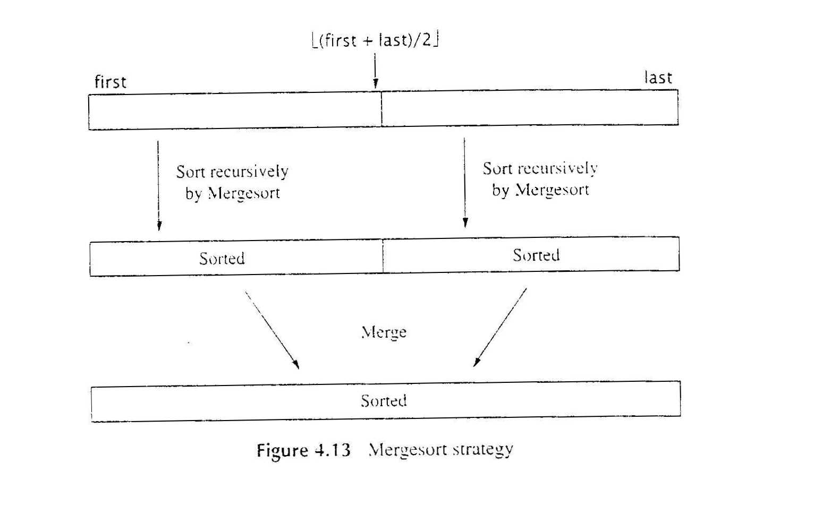
Mergesort : Using Divide and Conquer
Mergesort Strategy

Slide 4
Using Divide and Conquer: Mergesort
Mergesort Strategy

Slide 5
Algorithm: Mergesort
  Input: Array A and indexes first (p) and last (r).
  Output: A[first], …, A[last] is sorted rearrangement of the same elements
Pseudocode for MergeSort
MERGESORT(A, p, r)
if p< r
then q← floor[(p+r)/2]
MERGESORT(A, p, q)
MERGESORT(A, q+1, r)
MERGE(A,p,q,r)

Slide 6
MERGE(A,p,q,r) - Merging Sorted Sequences
Problem:
  Given two sequences A and B sorted in nondecreasing order,
  merge them to create one sorted sequence C
Strategy:
  determine the first item in C:
  It is the minimum between the first items of A and B.
  Suppose it is the first items of A. Then, rest of C consisting of merging rest of A with B.
Example: A (12, 34, 38, 78) B( 2, 56, 87, 90, 98)
C(2, 12, 34, 38, 56, 78, 87, 90, 98)

Slide 7
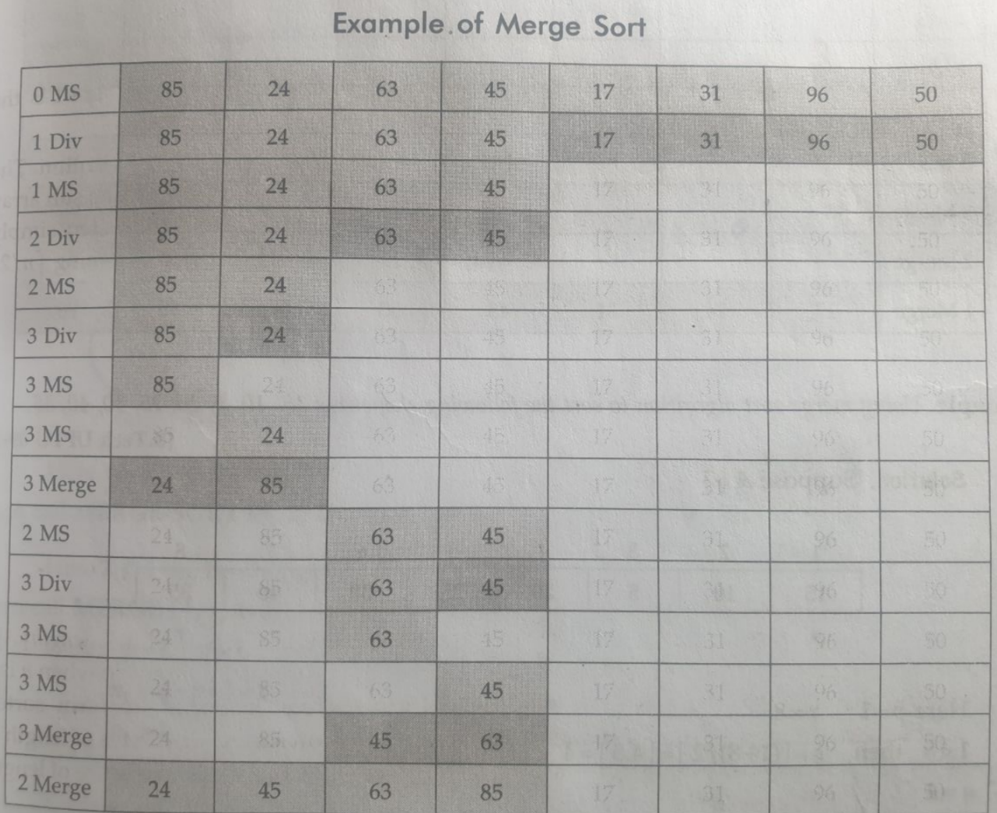
MERGESORT(A, p, r)
if p< r
then q← floor[(p+r)/2]
MERGESORT(A, p, q)
MERGESORT(A, q+1, r)
MERGE(A,p,q,r)

Slide 8
Merge(A,p,q,r)
{
n1=q – p + 1
n2=r - q
Let L[1..n1] & R[1..n2] be new array
for ( i= 0 to n1-1 )
L[i]= A[p+i]
for ( j= 0 to n2-1 )
R[j]= A[(q+1)+j]
i=0, j=0
for ( k= p to r )
if (L[i] <= R[j])
A[k] = L[i]
i =i +1
else
A[k] = R[j]
j=j+1
}

Slide 9
Merge(A,p,q,r)
{
n1=q – p + 1
n2=r - q
Let L[1..n1] & R[1..n2] be new array
for ( i= 0 to n1-1 )
L[i]= A[p+i]
for ( j= 0 to n2-1 )
R[j]= A[q+1+j]
MERGE SORT ANALYSIS
MERGESORT(A, p, r)
if p< r
then q← floor[(p+r)/2]
MERGESORT(A, p, q)
MERGESORT(A, q+1, r)
MERGE(A,p,q,r)
➔ O(n)
i=0, j=0
for ( k= p to r )
if (L[i] <= R[j])
A[k] = L[i]
i =i +1
else
A[k] = R[j]
j=j+1
}
Total Cost = Divide + conquer + merge
T(n) = C1 + 2T(n/2) + Cn
∈ O(n log n)

Slide 10
Space Complexity
Calculation of stack size :
In general, stack size will be levels in a tree, which is (log n),
Memory Requirement
Each merge-sort consumes = O (log n)
Merge Consumes = O(n)
Total space rqmnts = O (log n) + O(n) = O(n)
MERGESORT(A, p, r)
if p< r
then q← floor[(p+r)/2]
MERGESORT(A, p, q)
MERGESORT(A, q+1, r)
MERGE(A,p,q,r)
This is also called out-of-space / out-place algorithms as its needs extra array to do partial processing.
Extra space used by an algorithm depends on the input size.
It requires ‘n’ extra cells to copy elements from two sorted arrays into one, therefore each merge procedure requires O(n) memory. Since this memory is reused ‘log n’ times.
  The effective memory requirement is O(n)

Slide 11
Time Complexity
MERGESORT(A, p, r)
if p< r
then q← floor[(p+r)/2]
MERGESORT(A, p, q)
MERGESORT(A, q+1, r)
MERGE(A,p,q,r)
Divide n Conquer Notation
[ T(n)= Divide + Recursion+ Merge]
T(n) = O(1) + T(n/2) + T(n/2) + O(n)
= (n) + 2 T(n/2) [By masters theorem]
= Θ( n log n)
There is no worst scenario as it works same for ascending or descending order

Slide 12
Calculate the cost :
Given n elements, merge them using merge procedure to get one sorted list of n elements.

Slide 13
Calculate the cost :
Given n elements, merge them using merge procedure to get one sorted list of n elements.
Each merge procedure time to merge two sorted list into one and moving to next higher level = O(n)
Total levels to reach to the one sorted list = log n
➔ Total time = O(n) * log n = O (n log n)

Slide 14
Given “log n” sorted list each of size “n/log n”
what is the total time required to merge them into single sorted list

Slide 15
Given “log n” sorted list each of size “n/log n”
what is the total time required to merge them into single sorted list
N elements each of size 1 will take n*1 = O(n) | (log n) elements each of size n/logn will take (log n)* n/(log n) = O(n)
For n elements, number of levels will be log n | For (log n) elements, number of levels will be log (log n)
Total Cost = cost of merge at each level * total levels = O(n) * log n = O ( n log n) | Total Cost = cost of merge at each level * total levels = O(n) * log (log n) = O ( n log (log n))

Slide 16
“n” strings each of length “n” are given.
-What will be the time taken to sort them ?

Slide 17
“n” strings each of length “n” are given.
-What will be the time taken to sort them ?
Cost of merging n elements(size 1) = O(n)
Hence, cost of merging n strings, each of size n
=O(n) * O (n) = O(n²)
Total levels = (log n)
therefore,
Total Cost T(n) = O(n²) * log n = O(n²logn)

Slide 18
Assume that size k problem could be independently solved ( instead of 1)
n numbers (k<n) to be sorted
Compute the running time of Merge sort ?

Slide 19
Assume that size k problem could be independently solved ( instead of 1)
Compute the running time of Merge sort ?
Number of elements of size k to be merged (n/k)
Cost of merging k elements of size (n/k) = O (n)
Total numbers of levels = log (n/k)
➔ Total cost = O (n ) * log (n/k)
= O( n log (n/k))

Slide 20
Video Lecture of the topic can be found at
Quick Sort Analysis for various partitioning scenarios
https://youtu.be/gCP06CTpEaE
Merge Sort Algorithm
https://www.youtube.com/watch?v=RH0p7DYyMn4
Merge Procedure illustrative Example
https://www.youtube.com/watch?v=WzDq-WQALy0
Understanding Space Complexity
https://youtu.be/HEZdrU8ZPIk
Merge Sort Complexity Analysis
https://www.youtube.com/watch?v=x1dJx89Elf0
https://cexpertvision.com/2020/10/18/comparison-based-sorting-ca/

